Slide 1

Census Income Logistic Regression and Decision Tree
Barsha Bhattarai
BANA 320 Wed 7:00 PM
December 6,2023

Slide 2
Data Source:
UCI Machine Learning Repository
https://archive.ics.uci.edu/dataset/20/census+income
Census Income(Donated on 4/30/1996)
December 6, 2023

Slide 3
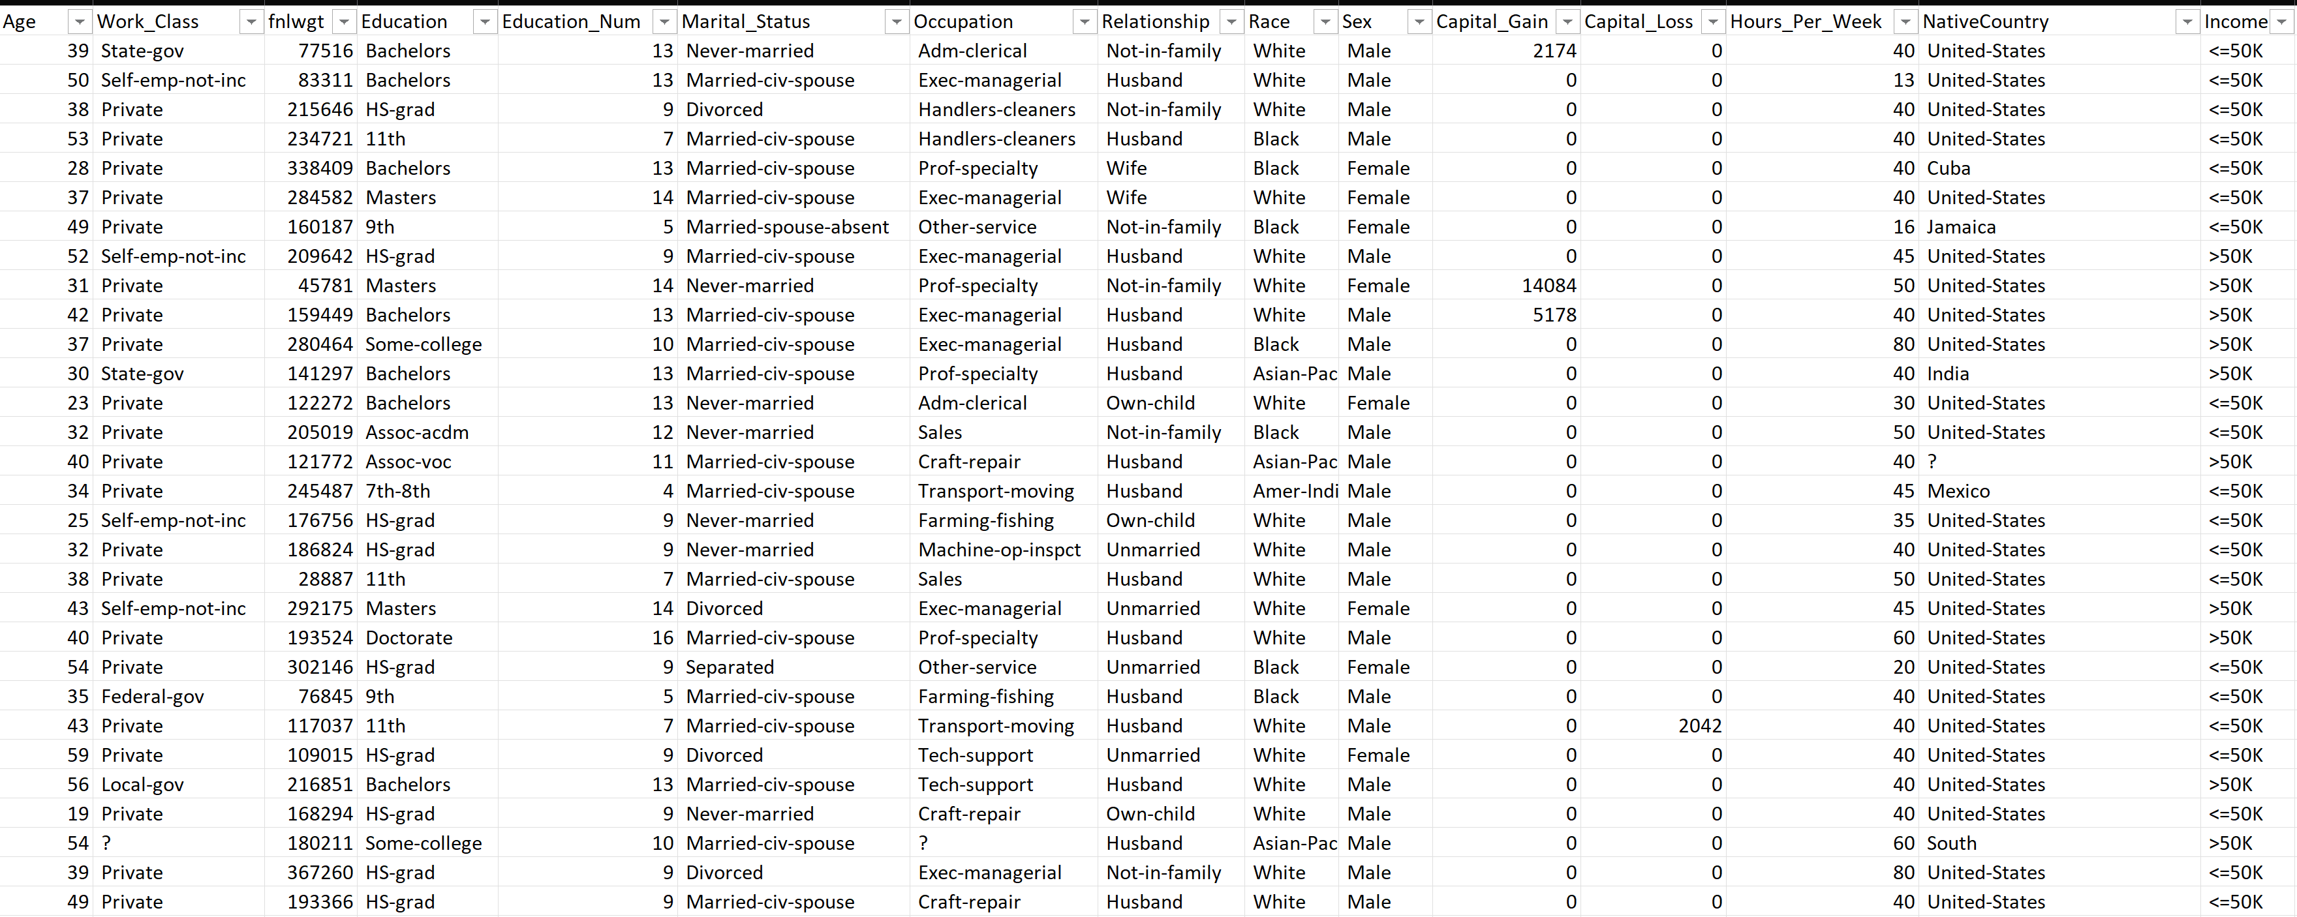
15 variables, 32561 observations

Slide 4
Data Understanding
Variables:
Age (Independent Variable)
Sex (Independent Variable)
Hours_Per_Week (Independent Variable)
Income (Dependent Variable)
Numerical data
Categorical data
Numerical data
Categorical data

Slide 5
Predict whether income exceeds $50K/year based on a Census data?
Target Variable: Income
Categories: >50K, <=50K
Variable has Categorical datatype
Classification problem
Logistic Regression and Decision Tree

Slide 6
Data Preparation
2. Checking for datatypes
Cen_Income.dtypes
Output: Age int64
Work_Class object
Education object
Marital_Status object
Occupation object
Relationship object
Race object
Sex object
Capital_Gain int64
Capital_Loss int64
Hours_Per_Week int64
Income object
dtype: object
1. Checking for any missing or null values
Cen_Income.isna().sum()
Output: Age 0
Work_Class 0
Education 0
Marital_Status 0
Occupation 0
Relationship 0
Race 0
Sex 0
Capital_Gain 0
Capital_Loss 0
Hours_Per_Week 0
Income 0
dtype: int64
2. Removing unnecessary columns
3. Checking for datatypes
3. Removing unnecessary columns
Cen_Income = Cen_Income.drop(columns = ['fnlwgt','Education_Num','NativeCountry’])
Cen_Income.shape
Output: (32561, 12)

Slide 7
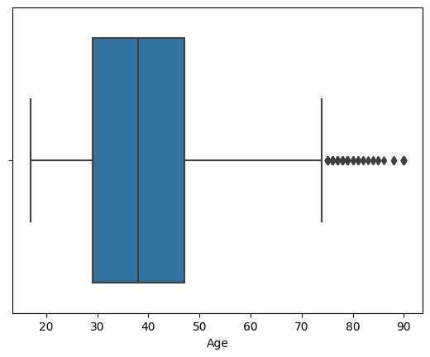
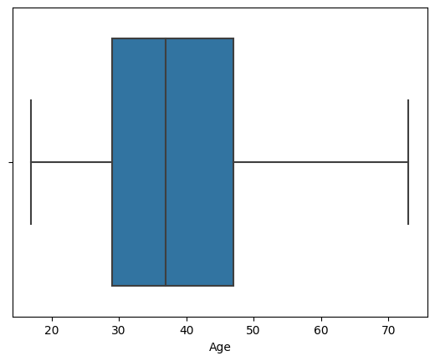
Before removing outliers
4. Checking for outliers (Boxplot)
sns.boxplot(data=Cen_Income, x='Age’)
q1 = Cen_Income['Age'].quantile(0.25)
q3 = Cen_Income['Age'].quantile(0.75)
iqr = q3 - q1
threshold = 1.5
lower_fence = q1 - threshold * iqr
upper_fence = q3 + threshold * iqr
Cen_Income =Cen_Income[(Cen_Income['Age']>lower_fence)&(Cen_Income['Age']<upper_fence)]
After removing outliers

Slide 8
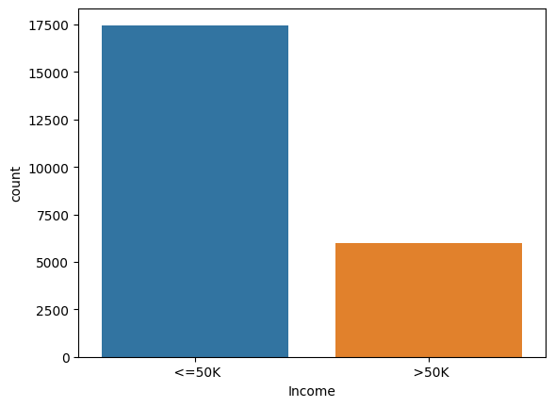
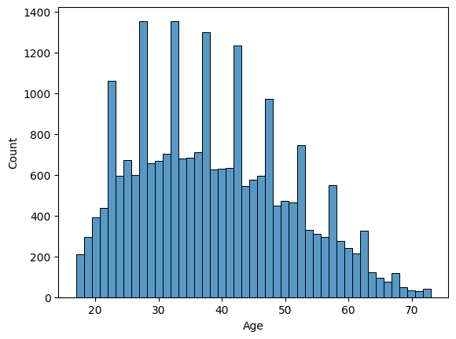
Data Visualization:
Count Plot showing count of each category of Income
Histogram showing frequency of Age

Slide 9
Model 1:
CenIncome_mod1 = Cen_Income[['Age','Hours_Per_Week','Income']]
X1 = CenIncome_mod1.drop('Income',axis=1)
Y = Cen_Income['Income']
Coefficients:
Intercept: -1.211221
Age: 0.606783
Hours_Per_Week: 0.437671
Logistic regression equation:
Logit(P(Income>50k)) = ln(P(Income>50k)/(1-P(Income>50k)))
=β0+β1*Age+β2*Hours_Per_Week
-=-
= -1.211221+0.606783*Age+0.437671*Hours_Per_Week

Slide 10
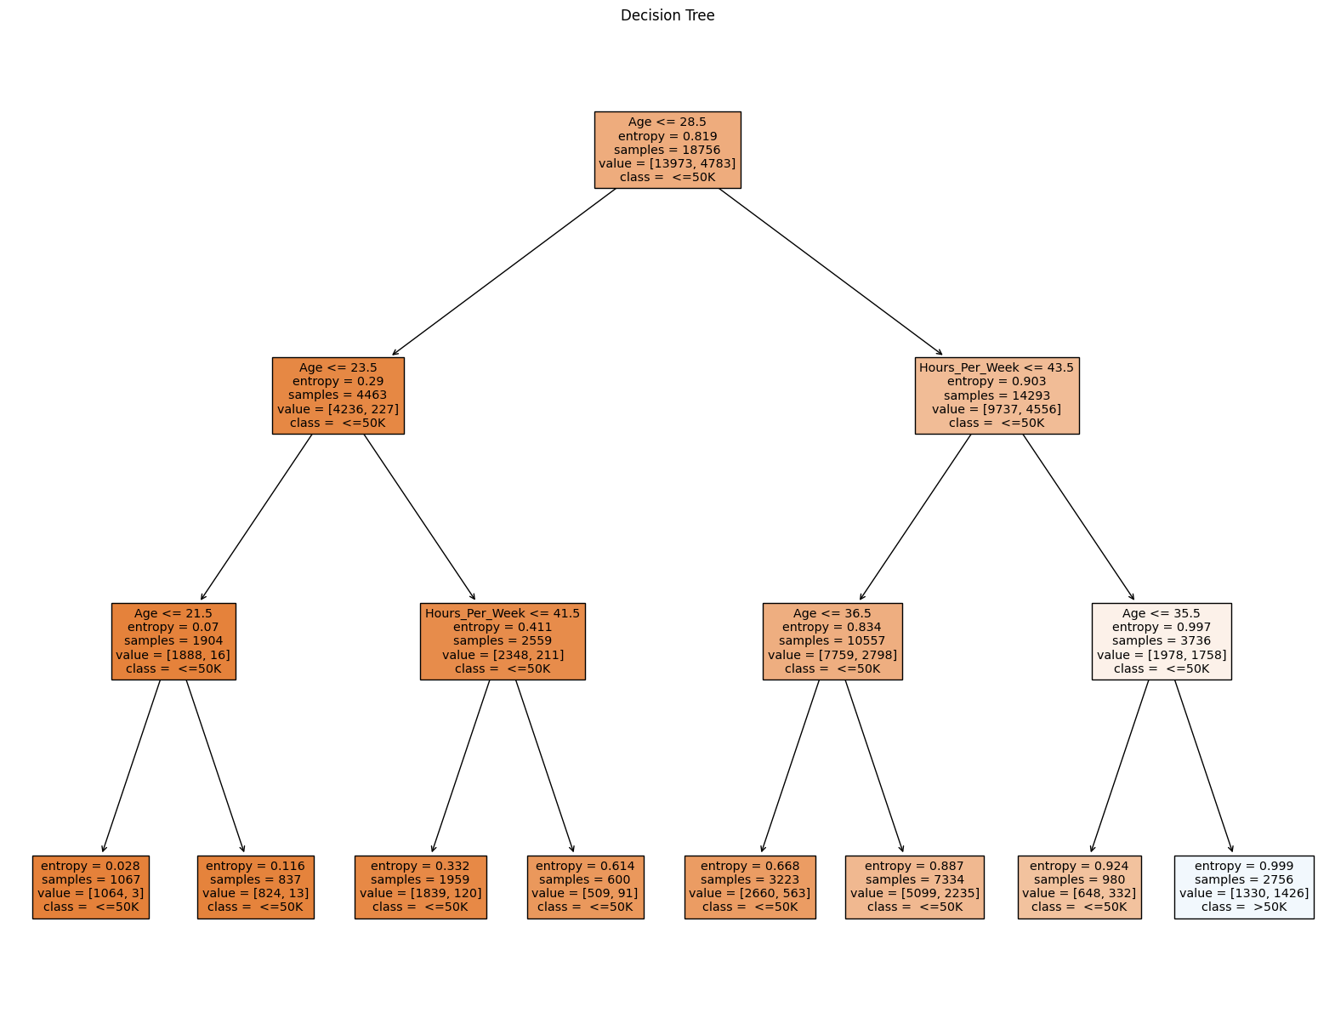
Model 2:
Model 2: Decision Tree
CenIncome_mod2 = Cen_Income[['Age','Hours_Per_Week','Income']] CenIncome_mod2.drop('Income',axis=1)
Y = Cen_Income['Income’]

Slide 11
Model Comparison
Model | Accuracy | AUROC
Model 1 (Logistic Regression) | 0.7395507534830822 | 0.7058418886422493
Model2 (Decision tree) | 0.7383237364043506 | 0.703330683251032

Slide 12
Insights
Primary goal is to identify and understand factors that determines whether an individual income exceeds$50K.
Helps to understand how work pattern is associated to higher income.
Helps in effective resources allocation, workforce planning and management strategies to improve financial situation of individuals, businesses and contribute to country economy as well.
Considering age and working hours, business can make informed decision which can impact employee well being in a positive way.

Slide 13

Thank you
Barsha Bhattarai

